Slide 1
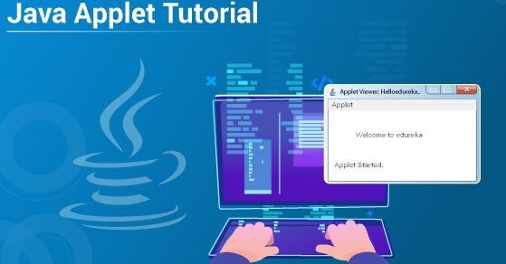
APPLET

Slide 2
OBJECTIVES
To explain the concept of applet.
To illustrate applet programs.
To outline applet architecture
To exemplify applet display methods.

Slide 3
INTRODUCTION
An applet is a Java program that can be embedded into a web page.
It runs inside the web browser and works at client side.
An applet is embedded in an HTML page using the APPLET tag.
Applets are used to make the web site more dynamic and entertaining.

Slide 4
INTRODUCTION
Important points
All applets are sub-classes (either directly or indirectly) of java.applet.Applet class.
Applets are not stand-alone programs.
Instead, they run within either a web browser or an applet viewer. JDK provides a standard applet viewer tool called applet viewer.

Slide 5
INTRODUCTION
Important points
An applet class will not define main().
When a user views an HTML page that contains an applet, the code for the applet is downloaded to the user's machine.
A JVM is required to view an applet.

Slide 6
INTRODUCTION :
A simple Applet class
import java.awt.*;
import java.applet.*;
public class SimpleApplet extends Applet
{
public void paint(Graphics g) {
g.drawString("A Simple Applet", 20, 20);
}
}

Slide 7
INTRODUCTION
The first imports the Abstract Window Toolkit (AWT) classes.
Java AWT (Abstract Window Toolkit) is an API to develop GUI or window-based applications in java..
The second import statement imports the applet package, which contains the
class Applet.

Slide 8
INTRODUCTION
Inside SimpleApplet, paint( ) is declared.
paint( ) is called each time that the applet must redisplay its output.
The paint( ) method has one parameter of type Graphics.
This parameter contains the graphics context, which describes the graphics environment in which the applet is running.

Slide 9
INTRODUCTION
Inside paint( ) is a call to drawString( ), which is a member of the Graphics class.
This method outputs a string beginning at the specified X,Y location.
It has the following general form:
void drawString(String message, int x, int y)
Here, message is the string to be output beginning at x,y.

Slide 10
INTRODUCTION
In a Java window, the upper-left corner is location 0,0.
The call to drawString( ) in the applet causes the message “A Simple Applet” to be displayed beginning at location 20,20.
Graphics class provides many methods for graphics programming.

Slide 11
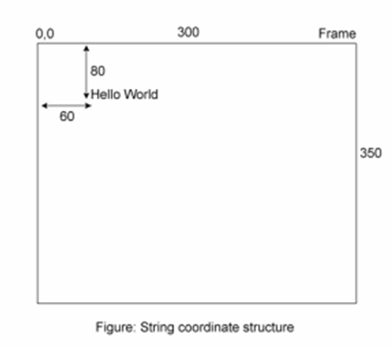
INTRODUCTION

Slide 12
RUNNING APPLETS
Applet does not have a main( ) method.
RUNNING APPLETS:Two ways
1)Executing the applet within a Java-compatible web browser.
2)Using an applet viewer, such as the standard tool, appletviewer. An applet viewer executes your applet in a window.

Slide 13
Executing applet in a web browser
To execute an applet in a web browser, you need to write a short HTML text file that contains a tag that loads the applet.
<applet code="SimpleApplet" width=200 height=60>
</applet>
After you create this file, you can execute your browser and then load this file, which causes SimpleApplet to be executed.

Slide 14
2)Using an applet viewer
import java.awt.*;
import java.applet.*;
/*
<applet code="SimpleApplet" width=200 height=60>
</applet>
*/
public class SimpleApplet extends Applet {
public void paint(Graphics g) {
g.drawString("A Simple Applet", 20, 20);
}
}

Slide 15
2)Using an applet viewer
1. Edit a Java source file.
2. Compile your program.
3. Execute the applet viewer, specifying the name of your applet’s source file.
The applet viewer will encounter the APPLET tag within the comment and execute your applet.
D:\>appletviewer SimpleApplet.java

Slide 16
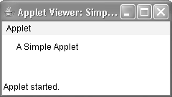
2)Using an applet viewer

Slide 17
Advantages of applets
It works at client side so less response time.
Secured.
Cross Platform:Applets are platform independent. This means that they are designed to work across various platforms.
Applets are supported by most web browsers.
It can move the work from the server to the client, making a web solution more scalable with the number of users/clients.

Slide 18
Disadvantages of applets
Plugin is required at client browser to execute applet.
Some browsers, notably mobile browsers running Apple iOS or Android do not run Java applets at all.
Some applets require a specific JRE

Slide 19
APPLICATIONS OF APPLETS
Java Applets are usually used to add small, interactive components or enhancements to a webpage that cannot be provided by HTML alone.
They can capture mouse input and also have controls like buttons or check boxes.
In response to the user action an applet can change the provided graphic content.

Slide 20
APPLICATIONS OF APPLETS
Applets are well suitable for demonstration, visualization, and teaching.
There are online applet collections for studying various subjects, from physics to heart physiology.
Applets are also used to create online game collections that allow players to compete against live opponents in real-time.

Slide 21
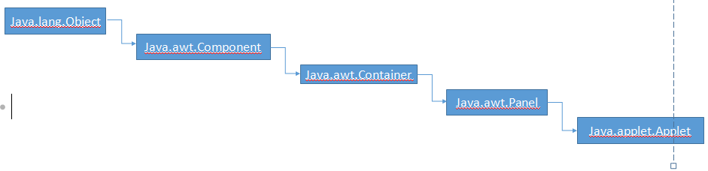
The Applet Class
Applet extends the AWT class Panel.
In turn, Panel extends Container, which extends Component. These classes provide support for Java’s window-based, graphical interface.

Slide 22
Applet Architecture
An applet is a window based program
1)Applets are event driven:-
It waits until an event occurs.
The run-time system notifies the applet about an event by calling an event handler that has been provided by the applet.
Once this happens, the applet must take appropriate action and then quickly return the control to the run-time system .

Slide 23
Applet Architecture
2)The user initiates the interaction with an applet
An applet is a window-based program
The user interacts with the applet when he or she wants.
These interactions are sent to the applet as events to which the applet must respond.
Eg:- when the user clicks a mouse inside the applet’s window, a mouse-clicked event is generated.

Slide 24
An Applet Skeleton
Most applets override a set of methods .
They provide the basic mechanism by which the browser or applet viewer interfaces to the applet and controls its execution
The methods are:
init(),start(), stop(), destroy() methods are defined by Applet class
paint() is defined by AWT Component class
Default implementations for all these methods are provided.
Applets do not override those methods they do not use.

Slide 25
Lifecycle of Java Applet
Lifecycle of Java Applet
Applet is initialized.
Applet is started.
Applet is painted.
Applet is stopped.
Applet is destroyed.

Slide 26
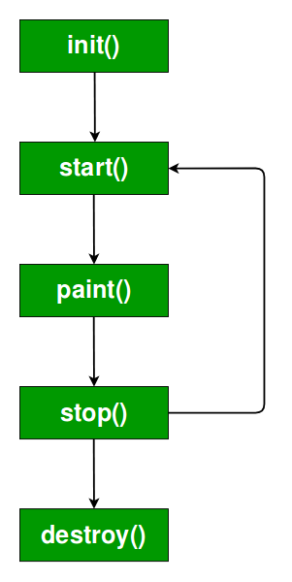

Slide 27
Lifecycle of Java Applet
public void init(): is used to initialize the Applet. It is invoked only once.
public void start(): is invoked after the init() method or browser is maximized. It is used to start the Applet.
public void stop(): is used to stop the Applet. It is invoked when Applet is stopped or browser is minimized.
public void destroy(): is used to destroy the Applet. It is invoked only once. Finally, when at last you're completely done browsing and close the browser, destroy() is run.

Slide 28
Lifecycle of Java Applet
java.awt.Component class
The Component class provides 1 life cycle method of applet.
public void paint(Graphics g): is used to paint the Applet. It provides Graphics class object that can be used for drawing oval, rectangle, arc etc.

Slide 29
// An Applet skeleton.
import java.awt.*;
import java.applet.*;
/*
<applet code="AppletSkel" width=300 height=100>
</applet>
*/
public class AppletSkel extends Applet {
// Called first.
public void init() {
// initialization
}
/* Called second, after init(). Also called whenever
the applet is restarted. */
public void start() {
// start or resume execution

Slide 30
}
// Called when the applet is stopped.
public void stop() {
// suspends execution
}
/* Called when applet is terminated. This is the last
method executed. */
public void destroy() {
// perform shutdown activities
}
// Called when an applet's window must be restored.
public void paint(Graphics g) {
// redisplay contents of window
}
}

Slide 31
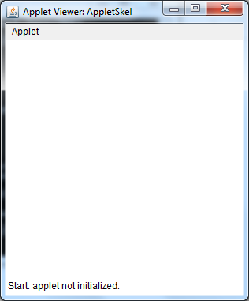
OUTPUT
D:\javac AppletSkel.java
D:\appletviewer AppletSkel.java

Slide 32
CONCLUSION
An applet is a Java program that can be embedded into a web page.
They run within either a web browser or an applet viewer.
init(),start(), stop(), destroy() methods are defined by Applet class
paint() is defined by AWT Component class

